Slide 1
WAREHOUSE
OPTIMIZATION IN THE

Slide 2
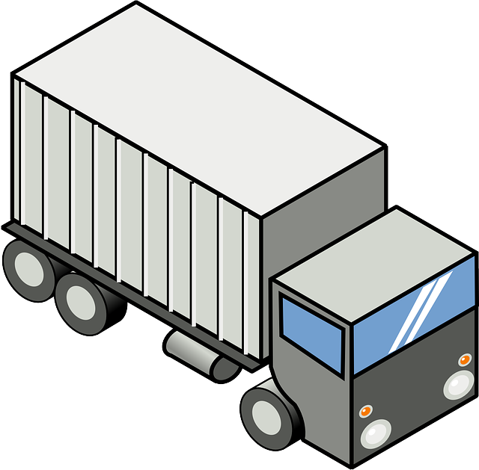
OPTIMIZATION IN THE WAREHOUSE
(You will need internet access for product links on the following pages to work)
WAREHOUSE STORAGE
ORDER PICKING
MANUAL
AUTOMATED
PACKAGING
RECEIVING
STAGING
SHIPPING
More Information

Slide 3
RECEIVING
Click links to see products
Air Curtains
Bins, Carts, Trucks & Totes
Bollards
Conveyor
Dock Boards
Dock Cage
Dock Door Sensors
Dock Plates
Door Guards
Fans
Folding Gates
Guard Rail
High Speed Doors
In-Plant Office
Labelers, Scanners
Mesh Insect Doors
Overhead Pallet Storage
Pallet Jacks
Pallet Positioners, Tilters, Rotators
Safety Gates
Scales
Stretch Wrapper
Track Guards
Vinyl Strip Doors
WCS
WMS
Work Stations
BACK TO MAIN

Slide 4
SHIPPING
Click links to see products
Banding/Strap Equipment
Bar Code Scanners
Cantilever Rack
Carton Flow
Carts & Trucks
Crating
Labelers
Palletizing – Auto
Palletizing – Manual
Safety Sensors
Scales
Skid Materials
Staging
Stretch Wrapper
WCS
WMS
Work Benches
BACK TO MAIN

Slide 5
STORAGE - MANUAL
Click links to see products
Balancers & Hoists
Bins/Containers/Totes
Bollards
Carton Flow
Carts & Casters
Cat Walks
Curtain Walls
Dollies, Trucks
Drum Handling
Fall Protection
Fans – HVLS
Floor Mats
Guard Rail
Hoppers
In-Plant Office
Lighting
Marking Tape
Mezzanines
Pallets
Pallet Jacks
Pallet Rack
Rolling Ladders
Safety Mirrors
Safety Sensors
Scissor Lift
Shelving
Spill Containment
Stainless Storage
Tables
Work Stations
Wire Caging
Wire Partitions
BACK TO MAIN

Slide 6
STORAGE - AUTOMATED
Click links to see products
AGV
AS/RS
Balancers
Carts
Conveyor
Carousels/VLM
Cranes & Hoists
Crossovers
Curtain Walls
Dispensers
HVLS
In-Plant Offices
Lifts, Positioners, Stackers
Light Curtains
Machine Guarding
Mezzanines
Mobile Rack/Aisles
Safety Cages
Safety Rails
Scanners
Sorters
Spill Containment
Tugs
VGV
VRC
WCS
WMS
Work Stations
BACK TO MAIN

Slide 7
ORDER PICKING
Click links to see products
Bins/Totes
Carousels
Carts/Trucks
Dispensers
Labelers
Pick-to-Light
Pick – RF
Pick-to-Voice
Scanners
Sorters
WCS
WMS
Work Stations
BACK TO MAIN

Slide 8
STAGING/PACKAGING
Bins/Totes
Carts/Trucks
Conveyor
Floor Marking Tape
Floor Mats
Lifts/Positioners/Tilters
Pallets
Pallet Jacks
Safety Sensors
Scales
WCS
WMS
Work Benches
BACK TO MAIN

Slide 9
OPTIMIZATION IN THE
WAREHOUSE
For more information, please contact:
call: 888-877-3861
See our website: www.cisco-eagle.com
BACK TO MAIN

